Slide 1
Decision Support Tool for Head and Neck Cancer
Aryan Vikas Jain, Emmet Campbell, Ghozlan Alhajeri,
Hind Alyaqot & Sarah Forde
Notes:
Good day everyone. Our group members are Aryan, Emmet, Ghozlan, Hind and Sarah. For our bluesky project, we created a decision support tool for head and neck cancer.

Slide 2

HEAD & NECK CANCER (HNC)
7th most common cancer worldwide
Increasing incidence
90% squamous cell carcinoma
Varying survival rates
Prevalence
2-3x more likely in men
40 years of age
Key risk factors
Smoking & alcohol consumption
HPV16 subtype infection
Notes:
This presentation will first give a brief overview of head and neck cancer.
Head and neck cancer is the seventh most common cancer worldwide and has an increasing incidence. 90% of cases are squamous cell carcinoma. Studies have shown that survival rates differ between geographical locations, tumour sites, and stage of diagnosis
Smoking tobacco and drinking alcohol are key risk factors in HNC and account for 72% of HNC cases.
Regardless of whether they consume alcohol or use cigarettes, men are 2 to 3 times more likely than women to develop head and neck cancer. Additionally, people who are over 40 years of age are more likely to develop head and neck cancer
It is well-known that HPV plays a role in the development of head and neck cancer and is a significant risk factor, especially for oropharyngeal cancer. Throat and mouth infections from HPV can result in oropharyngeal cancer. Oropharyngeal is the tonsils and base of the tongue near the back of the throat. There are different subtypes of HPV. The most frequent and prominent risk factor for several types of head and neck cancer, notably oropharyngeal malignancies, is oral cavity infection with cancer-causing HPV strains, especially HPV 16.

Slide 3
HNC AVAILABLE TREATMENTS
Oncology treatment regimen options
Concurrent chemoradiation therapy (CCRT)
Chemoradiotherapy (CRT)
Oestrogen replacement therapy (ERT)
Combined modality treatment (CMT)
Platinum-based chemotherapy
Cisplatin & carboplatin
Non-selective chemotherapy approaches
Ovarian, breast & colorectal cancers
Notes:
This is a summary of the common types of treatments recommended to head and neck cancer patients. Oncology treatment regimens options include CCRT, CRT, ERT and CMT.
These approaches combine radiotherapy and chemotherapy approaches.
Radiotherapy is a common form of anti-cancer treatment that beams high-energy radiation particles directly onto cancer cells.
Radiotherapy treatment approaches can take a duration of five days a week for up to 7-8 weeks of regimen. Each session would last up to 15 on the chosen treatment. The duration of radiotherapy treatments in the dataset ranged from 30 to 50 days of treatment; suggesting the duration the patient should expect.
Chemotherapy, also known as cytotoxic drugs, is an approach that uses drugs that destroy cancer cells. Chemotherapy may be given together with radiation to enhance the effectiveness of radiation treatment.
1) CCRT: combines radiotherapy and chemotherapy
- This type of regimen is recommended in cases where the cancer Has not spread to distant organs or if the patient Is deep-seated, not surgically accessible. Sometimes given after surgery to prevent reoccurrence.
2) CRT: A procedure that uses a computer to create a 3-dimensional picture of the tumor. This allows doctors to give the highest possible dose of radiation to the tumor, while sparing the normal tissue as much as possible.
3) ERT: Hormones play a role in female head and neck cancer patients, Thus ERT are recommended for such patients.
4) CMT: used to treat solid cancers. Can be a combination of Adjuvant, Induction and Concomitant approaches.Induction chemotherapy is the initial chemotherapy a person receives before undergoing additional cancer treatment. Adjuvant chemotherapy is used after other treatments to shrink remaining cancer cells. Concomitant chemoradiotherapy involves the simultaneous administration of the two modalities. Each approach has unique practical advantages to increase effectiveness of the treatment.
So for instance, clinicians might recommend platinum-based treatments. Platinum-based chemotherapy approaches include cisplatin and carboplatin, and are generally known as non-selective chemotherapy approaches to treat cancers such as ovarian, breast and colorectal cancers.

Slide 4
HNC AVAILABLE TREATMENTS
CHEMOTHERAPY REGIMEN
DRUG | DELIVERY | POTENTIAL SIDE EFFECTS
Cisplatin | Intravenous delivered infusion alkylating agent anti cancer drug (chemocare, 2023) | Nausea and vomiting Low blood cell count Kidney toxicity Hearing loss/ringing in ears Loss of appetite Hair loss
Docetaxel | Intravenous drip/central line delivered drug (cancer research UK, 2023) | Risk of infection Breathlessness/looking pale Bruising/bleeding/nosebleeds Hair/appetite loss Diarrhoea/muscle pain
Carboplatin | Intravenous injections over at least 15 minutes (medlineplus, 2023) | Nausea/diarrhoea Constipation Mouth/throat sores Hands/feet/place of injection pain Weakness/hair loss
Taxol | Intravenous drip; plastic tube stays in chest during treatment course (e.G. Central line/portacath) (cancer research UK, 2022) | Risk of infection Breathlessness/looking pale Bruising/bleeding Low blood pressure Hands/feet numbness/tingling Urinary tract infections (utis)
Notes:
Regimens can be weekly 3-7 weeks depending the patient’s need.
QUESTIONS:
CTLA4 polymorphisms
A number of molecular biomarkers of HNSCC CSCs have been proposed, with CD44, CD133 and ALDH1 being the most extensively validated and associated with prognostic significance.
HNSCC tumours exhibited frequent mutation of CDKN2A (22% of tumours) and TP53 (72% of tumours)
A poorly differentiated tumour is characterized by immature cells with nuclear pleomorphism and atypical mitoses, with minimal to no organized stratification or keratiniza- tion
No validated tool exists for screening for HPV-positive HNSCC. HPV vaccinations are effective only for pri- mary prevention,
HNSCC might be more frequently driven by loss of tumour suppres- sors.
a central line – a long, thin tube put into a vein in the chest
Alkylating agents keep the cell from reproducing (making copies of itself) by damaging its DNA.
Radiotherapy is employed as a primary treatment or as an adjuvant to surgery.
It also suggests that the lower incidence of female HNCs may be due to a combination of exogenous and endogenous hormone exposure and different smoking and drinking risk exposures.
where the expression of sex hormone receptors is critical to define tumour subtypes with distinguishing biopathological characteristics and different responses to therapy
The expression patterns of sex hormone receptors in HNSCC is also unclear, which is unsurprising considering these difficulties and the heterogeneity of these tumours.
cisplatin is one of the most effective drugs for ovarian cancer with as many as 80%Trusted Source of people having an initial response.
IMMUNOTHERAPY: FDA approves pembrolizumab for first-line treatment of head and neck squamous cell carcinoma. On June 10, 2019, the Food and Drug Administration approved pembrolizumab (KEYTRUDA, Merck) for the first-line treatment of patients with metastatic or unresectable recurrent head and neck squamous cell carcinoma (HNSCC).
Often given in combinations to increase effectiveness. For example, the most effective chemotherapy regimen is weekly cisplatin, hydroxyurea + cisplatin, 5-FU + cisplatin, however this approach is considered controversial and is still being tested in clinical trials.

Slide 5
HNC AVAILABLE TREATMENTS
SURGICAL OPTIONS
Neck dissection Neck node dissection Modified left radical neck dissection Tonsillectomy (removal of palatine tonsils) Bilateral tonsillectomy Maxillectomy (removal of part of the upper jaw) Mandibulectomy (lower jaw removal) Laryngectomy (removal of voice box) Hemiglossectomy (removal of the lateral half of the tongue) Thyroidectomy (removal of part/whole thyroid gland) Total pharyngolaryngectomy (removal of voice box and back of the throat and mouth)
COMBINATIONS
Tonsillectomy + Radical neck dissection Tonsillectomy + Neck node dissection Total laryngectomy + Neck node dissection Salvage tonsillectomy + Neck node dissection Total laryngectomy + Neck node dissection + Thyroid lobectomy (removal of one thyroid lobe)
Notes:
Surgical interventions can be used in combination depending on the site of the tumours.
Additional treatment: Some HNC cases may require salvage surgeries or postoperative ERT treatment for female patients.
This provides the patient with an idea on what to be expected in head and neck cancer treatment and guides their decision on whether to undergo treatments or not.

Slide 6

CLINICAL DECISION-MAKING
Medical decision
Multi-faceted & complex
Clinical experience & available research
Paternalistic model
Clinicians considered sole decision makers
Retained all medical knowledge
Responsibility for screening, treatment & management
Restrict patient autonomy
Informed consent
Provide patients with information about medical care
Accountable for own well-being
Notes:
We are now going to focus on clinical decision-making and its importance in oncology.
Making medical decisions is a multi-faceted and complex process. In particular, oncology decisions are not always evidence-based, but additionally require consideration of clinical experience and available research.
Historically, the paternalistic model primarily governed medicine where clinicians
were considered the sole decision makers and retained all medical knowledge.
Therefore, under this model, clinicians bear the responsibility of deciding on screening, treatment and patient management without consulting patients or their relations and this restricts patient autonomy.
Following the requirement of informed consent, there was an increased acknowledgment for providing patients with information about their medical care
majority of patients have reportedly expected to contribute to the decisions made about their health as they feel accountable for their well-being.

Slide 7

CLINICAL DECISION-MAKING
Consumer model
Clinicians diagnose & provide treatment options
Give patient substantial autonomy
Great uncertainty & lack of clinician support
Approach decision-making from different perspectives
Clinicians: evidence
Patients: psychological factors
Shared decision-making
Mutually agreed healthcare decisions
Patient-centric approach
Challenge: decisional conflict
Notes:
Another approach, the consumer model, employs clinicians to diagnose the health issue, provide treatment options, and give the patient substantial autonomy to make decisions.
However, this can cause the patient great uncertainty and clinicians may not support the treatment plan chosen (for example natural remedies).
Decision-making is approached from different perspectives. Clinicians tend to plan treatment based on evidence and patients may consider psychological factors such as previous experiences, quality of life and life expectancy.
Shared decision making allows patients and their clinicians to make mutually agreed healthcare decisions together based on currently available evidence. This approach encourages a patient-centric approach to treatment.
A challenge faced by SDM is decisional conflict where patients may experience uncertainty about which treatment path is best suited for them.
Patients are likely to delay making a decision, regret/change their choice, and blame their clinicians for negative outcomes

Slide 8

DECISION-MAKING AIDS
Translate information into accessible forms
Disease prevalence & pathophysiology
Risk factors
Available treatments
Benefits & risks
Outcome probabilities
Reduce delusional conflict
Adherence to treatment regimens
Overall satisfaction
Patient-centric & preference-sensitive
Notes:
Patient decision-making aids can translate information into accessible forms to allow for understanding about; (i) disease prevalence and pathophysiology, (ii) risk factors, (iii) available treatments, (iv) benefits and risks, and (v) outcome probabilities.
It has been reported that these tools can significantly reduce delusional conflict and provide patient-friendly information to aid informed consent.
Studies have reported better adherence to treatment regimens and overall satisfaction of patients when they have been involved in decision-making.
Ultimately, these tools allow for a patient-centric and preference-sensitive SDM approach which is vital in oncology patients.

Slide 9
DECISION SUPPORT TOOL
HNC dataset
Grossberg, A. et al. (2017)
Presentation, diagnosis, treatment and monitoring data
215 patients
112 feature points
Data pre-processing
Overfitting
Excessive noise
Unable to fit all features
Restructured features
Refined model
Reduced overfitting
Improved performance
Notes:
We used a dataset from Grossberg et al which contained head and neck cancer patient presentation, diagnosis, treatment and monitoring data for 215 patients. This dataset comprised 112 feature points.
When training our model with all the features and developing various classifiers, we observed overfitting. This issue stemmed from the excessive noise in the dataset and the inability of the model to fit all features.
To address these challenges, we initiated several data pre-processing techniques such as the restructuring of categorical variables. We further refined our feature engineering and feature selection processes by eliminating less important features and identifying the most informative ones. However, this resulted in the reduction in the number of patients retained in the dataset.
By focusing on these key features, our refined model better addressed the limited dataset size and reduced overfitting. The model's improved performance demonstrated the value of data pre-processing and feature selection in enhancing the accuracy and reliability of machine learning models, particularly when working with smaller datasets.

Slide 10
DECISION SUPPORT TOOL
15 shortlisted features
Sex
Age
Height (m)
Diagnosis
Grade
HPV status
Induction Chemotherapy
Chemotherapy Regimen
Platinum-based chemotherapy
Received Concurrent Chemoradiotherapy
CCRT Chemotherapy Regime
Surgery Summary
Smoking History
Current Smoker
Stage
Notes:
After data pre-processing was complete, these were the 15 shortlisted features

Slide 11
DECISION SUPPORT TOOL
To provide patients with a clearer understanding of their diagnosis which can aid shared decision-making
an accessible, visual overview of HCN patients exhibiting similar presentations & diagnosis
Notes:
The aim of this decision support tool is to provide patients with a clearer understanding of their diagnosis which can aid shared decision-making.
Patients can contextualise their presentation, diagnosis, and treatment options. This tool provides an accessible, visual overview of HCN patients exhibiting similar presentations and diagnosis to current patients

Slide 12
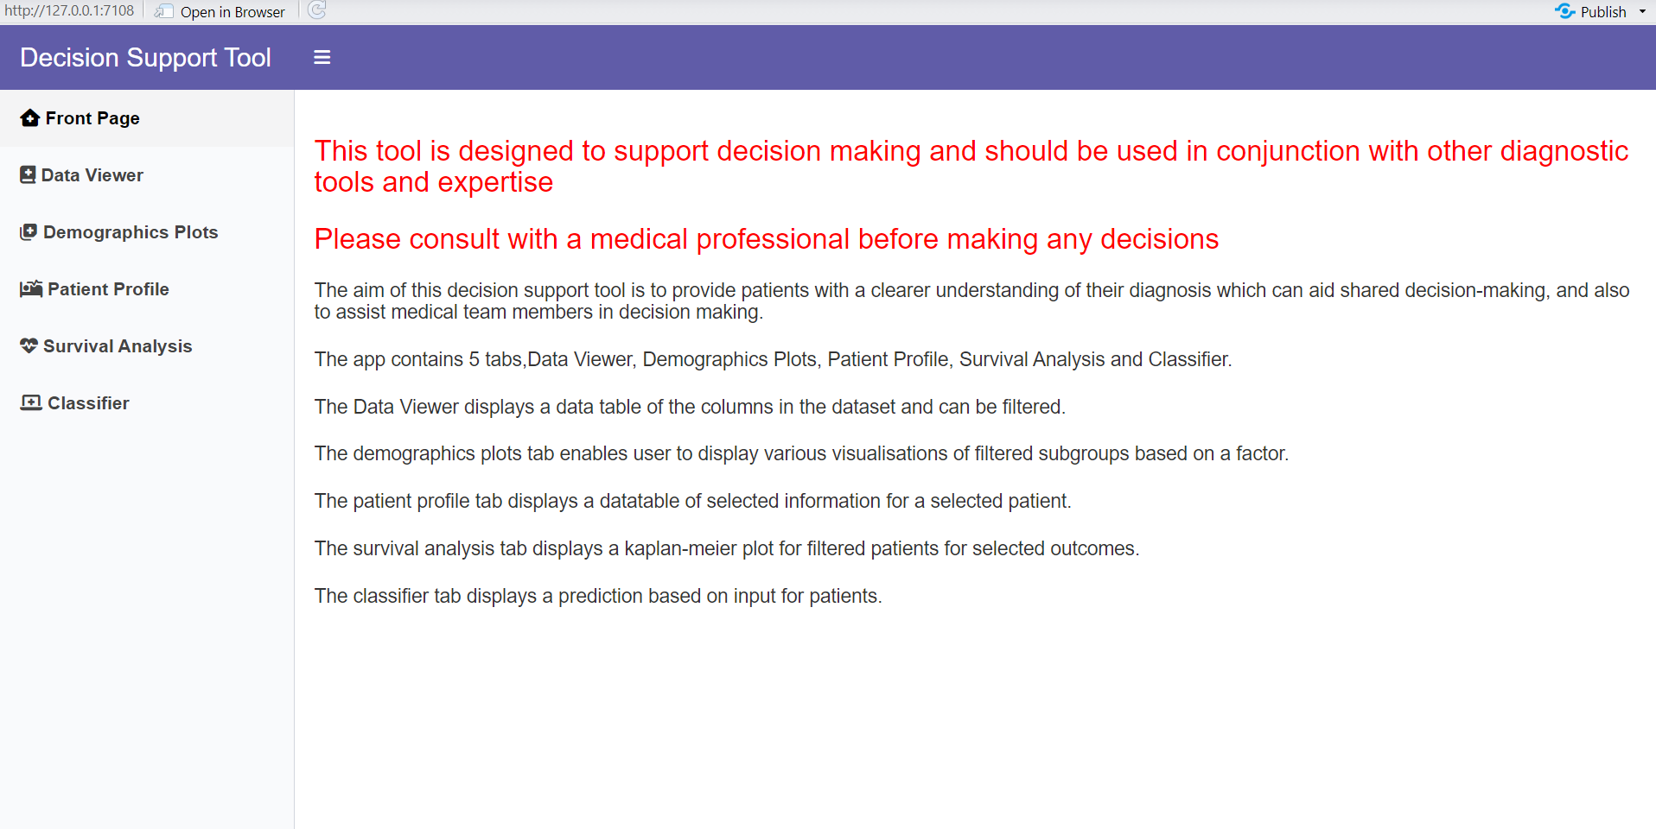
DECISION SUPPORT TOOL - Front Page
This is the front page of the tool. It provides an explanation and how best to use the tool.

Slide 13
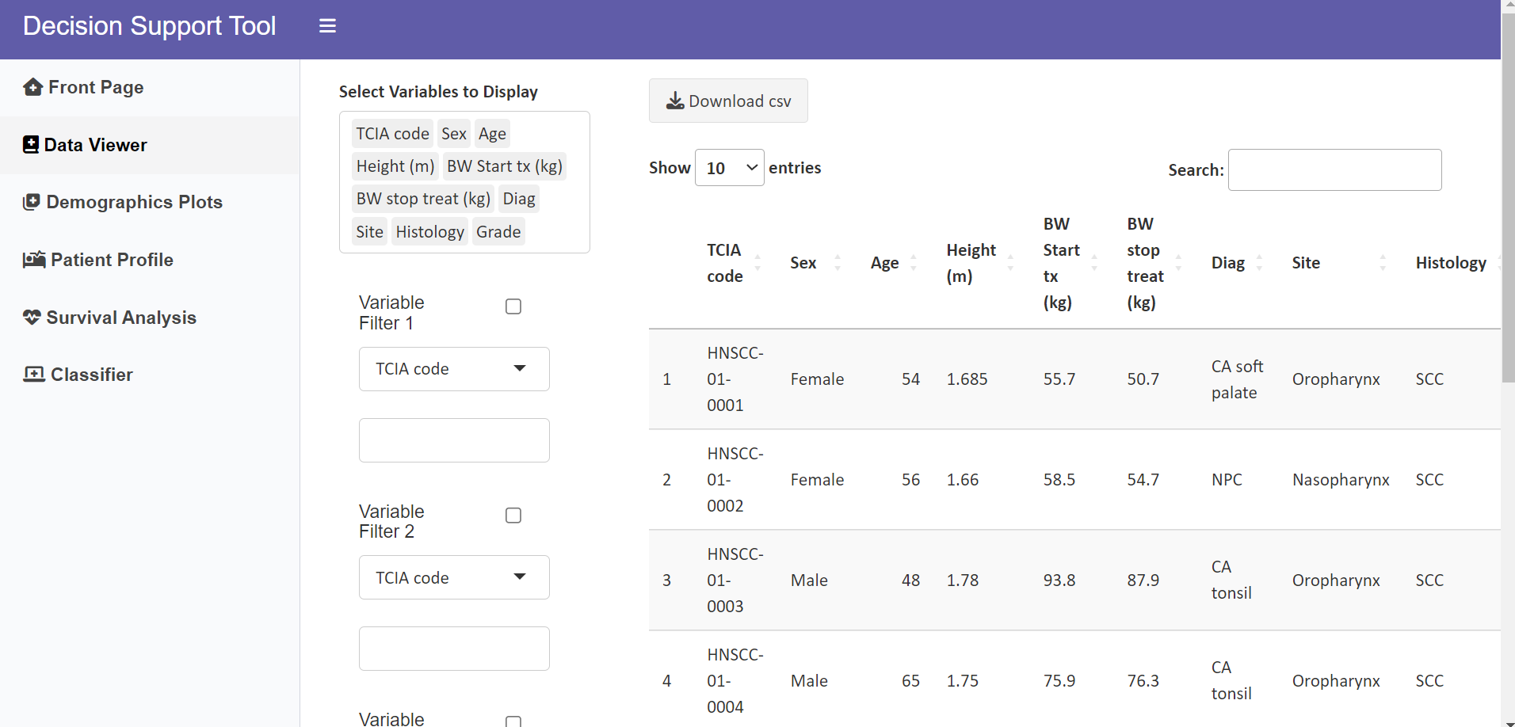
DECISION SUPPORT TOOL - Data Viewer
This tab shows an overview of the data used within the app.

Slide 14
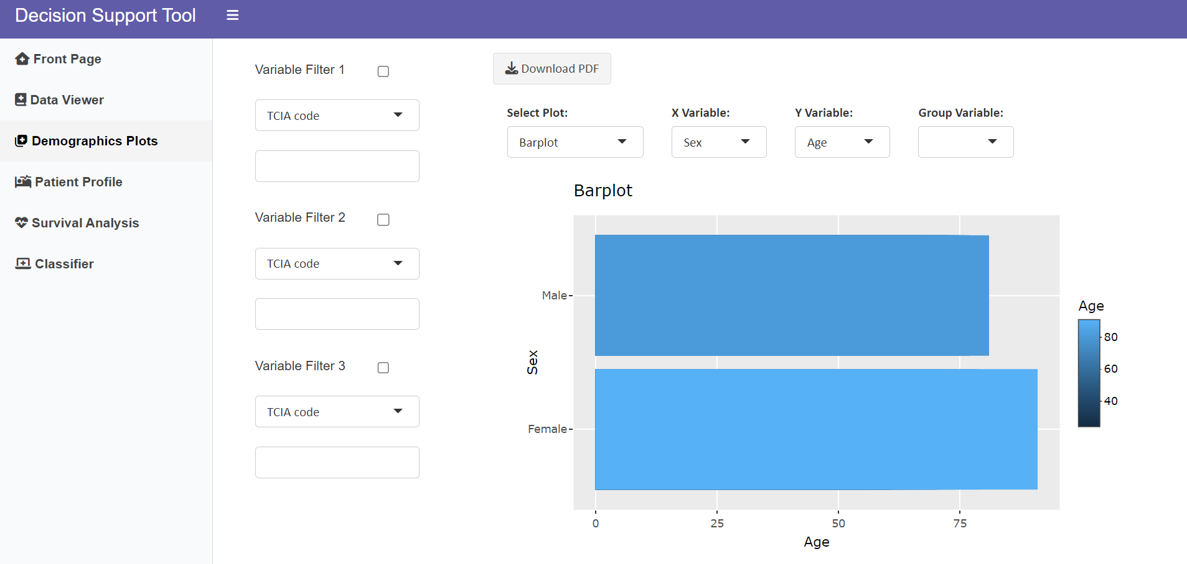
DECISION SUPPORT TOOL - Demographics Plots
This tab displays various visualizations of the data within the tool.

Slide 15
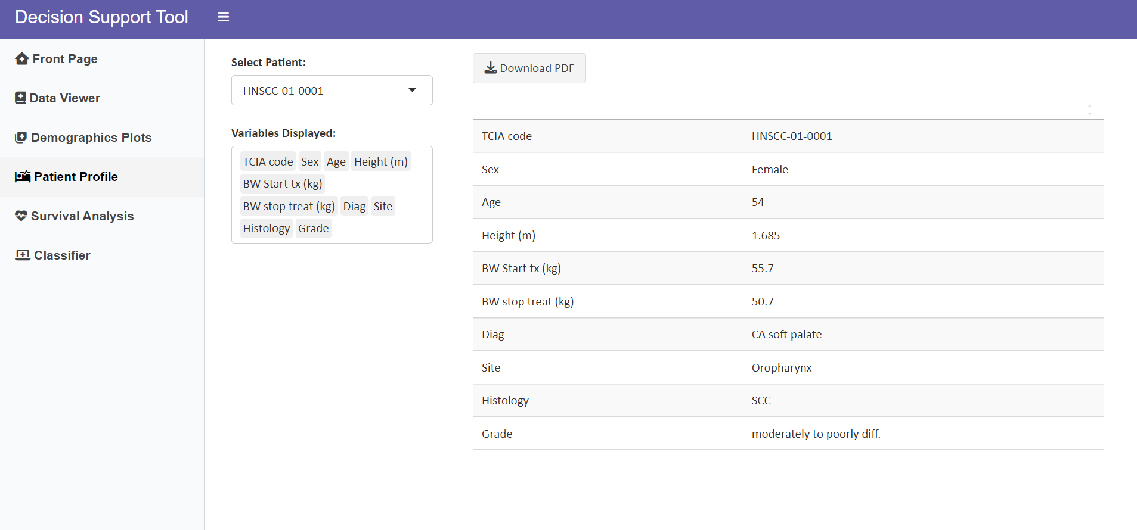
DECISION SUPPORT TOOL - Patient Profile
This tab displays and data on a specific selected patient

Slide 16
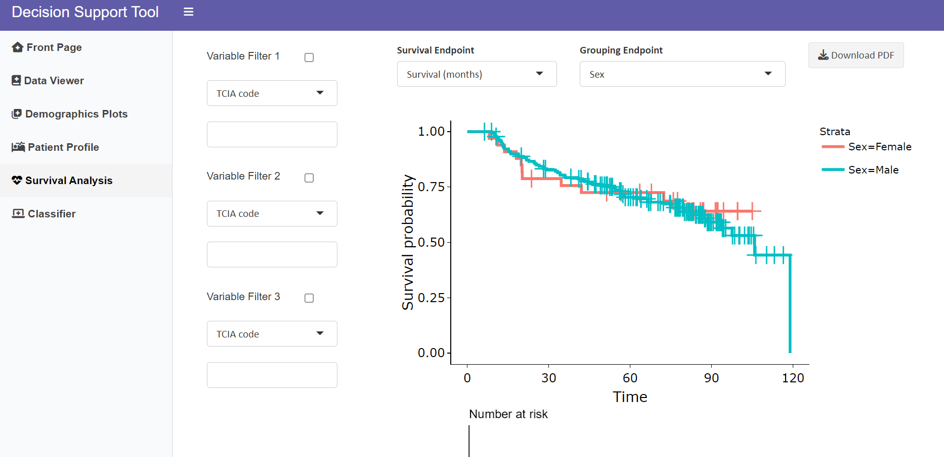
DECISION SUPPORT TOOL - Survival Analysis
This tab display a Kaplan-Meier curve and number at patients risk table.

Slide 17
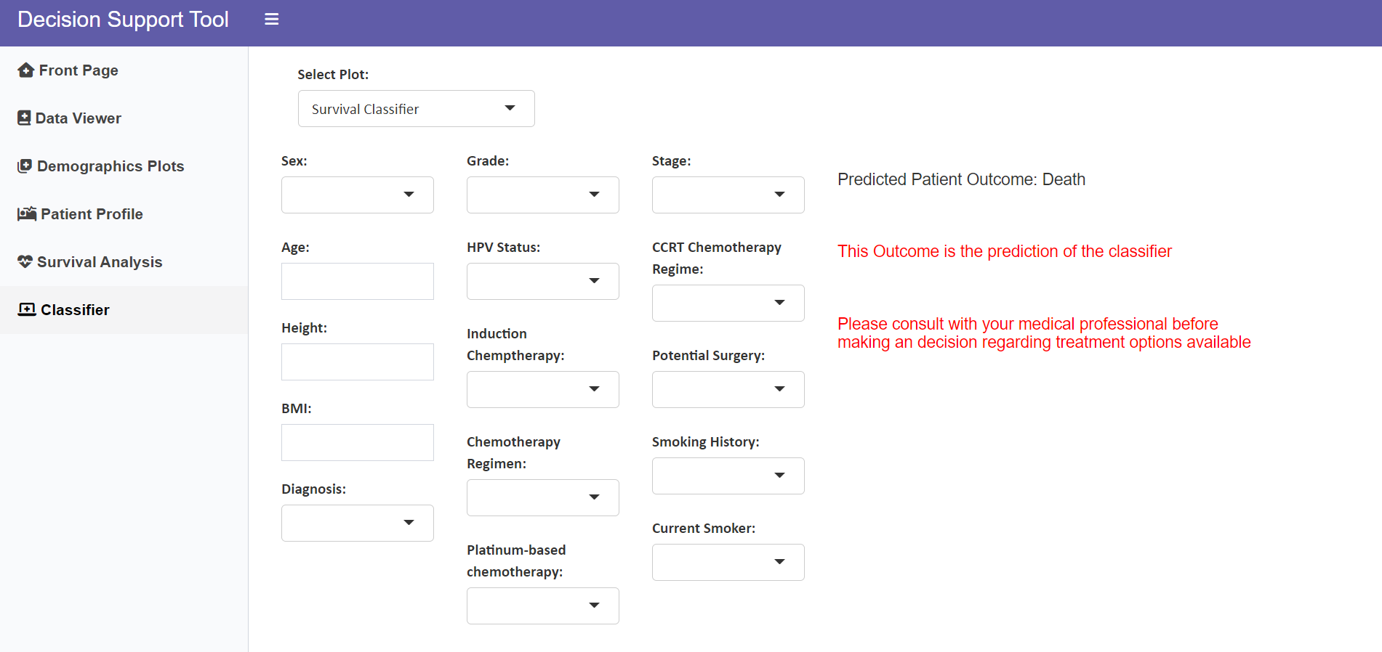
DECISION SUPPORT TOOL - Machine Learning Classifier
This tab displays a Survival and Recurrence classifier based on entered patient characteristics.

Slide 18
Machine Learning Classifier
2 Classifiers were generated
Alive or Dead
Response or Recurrence
Models Tested:
Logistic Regression
Decision Tree
Random Forest
Gradient Boosting
Support Vector Machine
K-Nearest Neighbours
Navie Bayes
XGBoost Classifier
Bagging Classifier

Slide 19
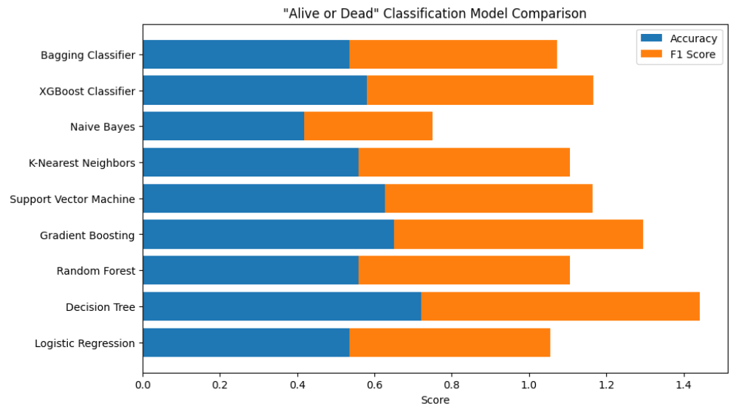
Alive or Dead Classifier Accuracies and F1 Scores
Bagging Classifier: Accuracy = 0.53, F1 Score = 0.54
XGBoost Classifier: Accuracy = 0.58, F1 Score = 0.59
Naive Bayes: Accuracy = 0.42, F1 Score = 0.33
K-Nearest Neighbors: Accuracy = 0.56, F1 Score = 0.55
Support Vector Machine: Accuracy = 0.63, F1 Score = 0.54
Gradient Boosting: Accuracy = 0.65, F1 Score = 0.64
Random Forest: Accuracy = 0.56, F1 Score = 0.55
Decision Tree: Accuracy = 0.72, F1 Score = 0.72
Logistic Regression: Accuracy = 0.53, F1 Score = 0.52

Slide 20
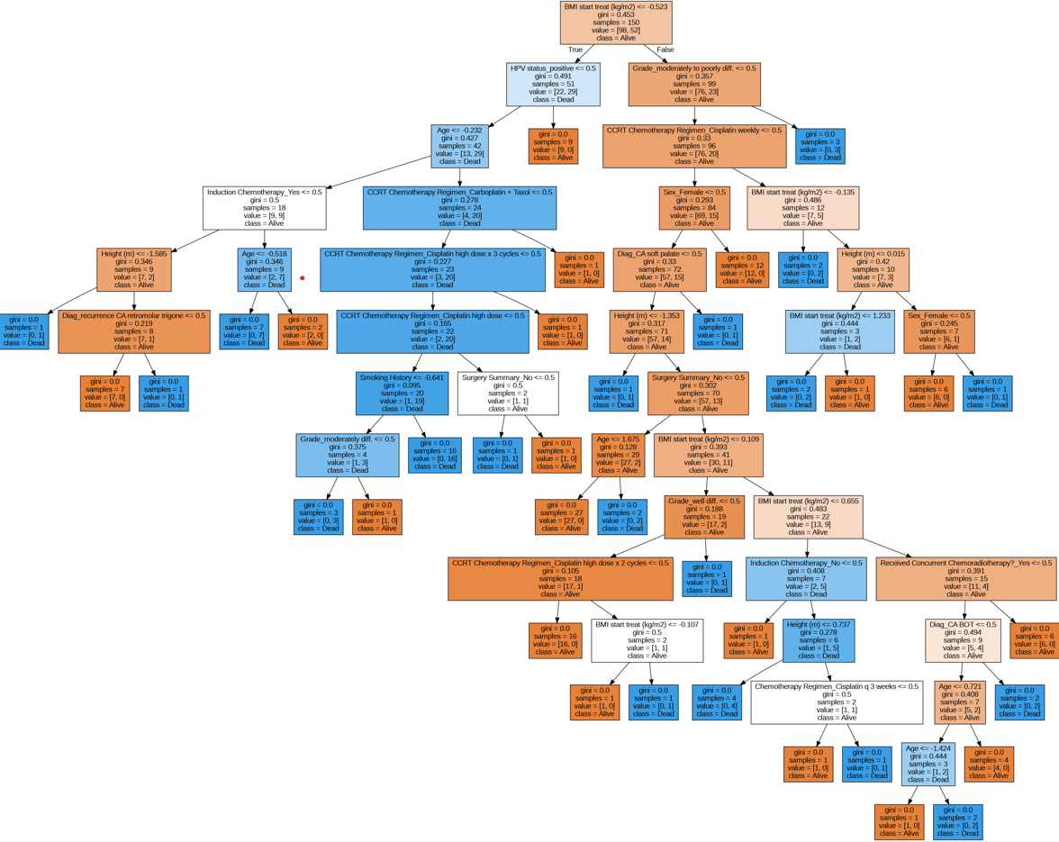
Alive or Dead Decision Tree

Slide 21
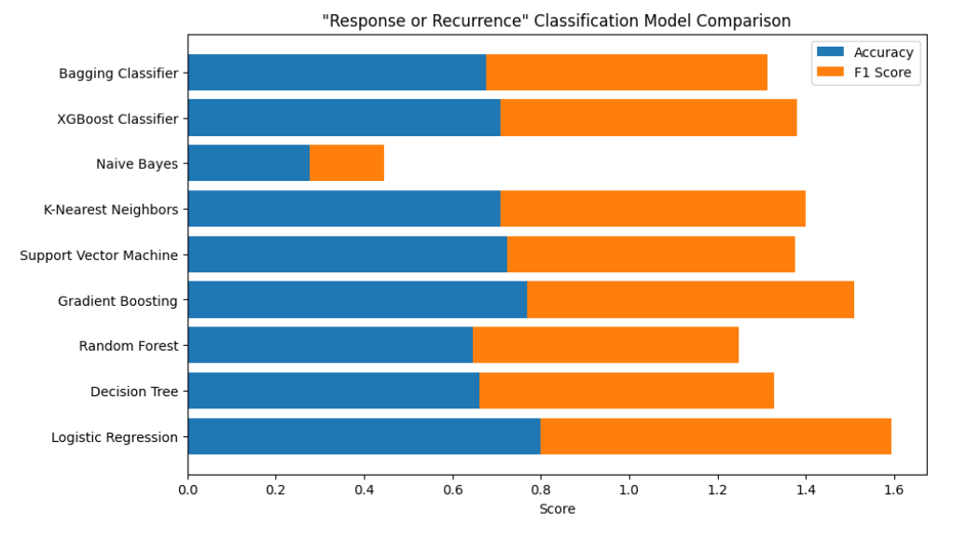
Response or Recurrence Classifier Accuracies and F1 Scores
Bagging Classifier: Accuracy = 0.68, F1 Score = 0.64
XGBoost Classifier: Accuracy = 0.71, F1 Score = 0.67
Naive Bayes: Accuracy = 0.28, F1 Score = 0.17
K-Nearest Neighbors: Accuracy = 0.71, F1 Score = 0.69
Support Vector Machine: Accuracy = 0.72, F1 Score = 0.65
Gradient Boosting: Accuracy = 0.77, F1 Score = 0.74
Random Forest: Accuracy = 0.65, F1 Score = 0.60
Decision Tree: Accuracy = 0.66, F1 Score = 0.67
Logistic Regression: Accuracy = 0.80, F1 Score = 0.79

Slide 22


LIMITATIONS & FUTURE APPLICATIONS
Larger & more diverse dataset
Include:
HPV subtypes
Genetic & epigenetic data
Image analysis results
Family history
Additional treatment options
Different cancers
Online Q&A support tool
Links to other patient-centric websites & available clinical trials
Notes:
There are some limitations of this app. For instance, A much larger and more diverse dataset should be used to inform the AI of this tool. Additionally, this tool would be significantly strengthened if the dataset included detailed HPV subtype, genetic and epigenetic analysis, available imaging analysis results, and family history data from previous patients.
there may be other treatment options which interest patients that are not included in the dataset. For example, herbal/natural alternatives or other pharmaceutical compounds. Therefore, this somewhat restricts the applicability of this tool.
With substantial development, this tool has the potential to be applied to various cancers in addition to HCN. Other applications of this tool could include an online Q&A tool for patients to actively interact with medical professionals when viewing this information as well as hyperlinks to available patient-centric websites and available clinical trials.

Slide 23
Thank you

Slide 24
IMAGES
https://www.thehumancapitalhub.com/articles/paternalistic-leaders-everything-you-need-to-know
https://www.neurologybytes.com/migraine/empowering-patients-for-shared-decision-making-in-managing-their-migraine/
https://www.istockphoto.com/illustrations/decisions
https://www.vectorstock.com/royalty-free-vector/avoid-alcohol-and-smoking-health-care-themed-tip-vector-27422520
https://www.istockphoto.com/illustrations/diversity
https://www.123rf.com/clipart-vector/questions_and_answers.html

